Slide 1

INTERNSHIP PRESENTATION
SARAH TUCKER COLLEGE (AUTONOMOUS)
at
MavePizon Technologies, Tirunelveli
Car Price Prediction Using Machine Learning
Presented By,
R. Jenifer

Slide 2

COMPANY PROFILE
MAVEPIZON TECHNOLOGIES
Founded in 2024, based in Tirunelveli.
Provides IT solutions, skill-based training, and software development.
Focus areas: Web development, Mobile Apps, IoT, Cloud & DevOps.
Known for workshops, coding bootcamps, and academic collaborations.
Motto: 'Learn. Build. Deploy'.

Slide 3


Slide 4
INTRODUCTION
Internship provided practical experience in applying academic knowledge and gain industry practices.
Objectives:
Gain hands-on experience.
Develop technical and soft skills.
Understand workplace dynamics.
Build professional relationships.

Slide 5
ABSTRACT
Car price prediction is complex due to multiple influencing factors such as brand, model, mileage, fuel type, etc.
Machine learning models were used to estimate car prices based on historical data.
Random Forest and XG Boost achieved the best performance.
Helps buyers, sellers, and dealers make data-driven decisions.

Slide 6
PROJECT OVERVIEW : CAR PRICE PREDICTION
Predict the price for car by its car name using ML Model.
Key Features:
Car brand, year, mileage, engine size, fuel type, transmission.
Covered full ML pipeline:
Data collection → Preprocessing → EDA
→ Model Training → Evaluation → Deployment.

Slide 7
TOOLS AND TECHNOLOGIES
Python, Jupyter Notebook, Google Colab.
Libraries:
Pandas
NumPy
Matplotlib
Seaborn
Scikit-learn
XGBoost.
Streamlit for user-friendly web interface.
Git &GitHub : It is a version control used for tracking code and collaboration.

Slide 8
DEVELOPMENT PROCESS
Data Collection: Kaggle and online sources.
Preprocessing: Handle missing values, encoding categorical features, scaling numerical features.
EDA: Heatmaps, scatter plots, boxplots.
Feature Engineering: Car Age, mileage.
Model Training: Linear Regression, Decision Tree, Random Forest, XGBoost.

Slide 9
CHALLENGES ENCOUNTERED
Missing values and inconsistent data.
High cardinality: Too many unique car models in categorical type.
Overfitting solved using cross-validation and regularization.
Feature correlation and multicollinearity affected linear models.
Hyperparameter tuning used to finding the best value for machine learning model.
Time management constraints used in balancing coding and testing the dataset.

Slide 10
RESULTS
Achieved R² score of 84%(XGBoost).
Key features: Car brand, year, mileage, engine size, fuel type.
Target: Car Name
Developed a working ML model used to predict car price using car name.
Gained practical experience in real-world ML workflow.

Slide 11
KEY LEARNINGS
End-to-end ML pipeline implementation.
Technical skills in Python, Scikit-learn, XGBoost.
Handling real-world data challenges.
Model evaluation and comparison.
Handling missing data, outliers, and overfitting.
Improved problem solving, planning, and communication skills.

Slide 12
VISUALIZATION

Slide 13
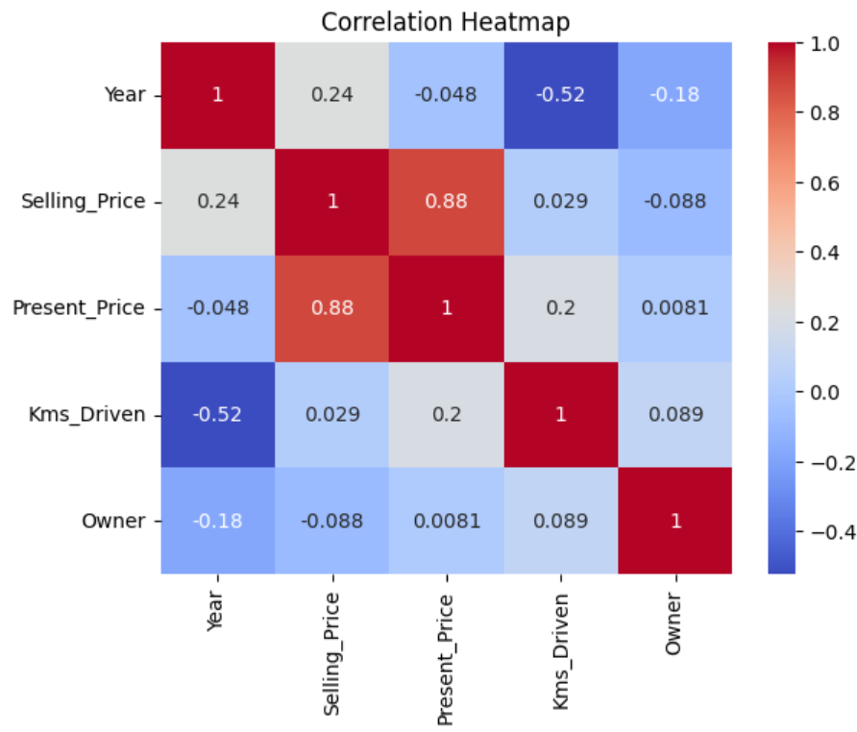
CORRELATION HEATMAP

Slide 14
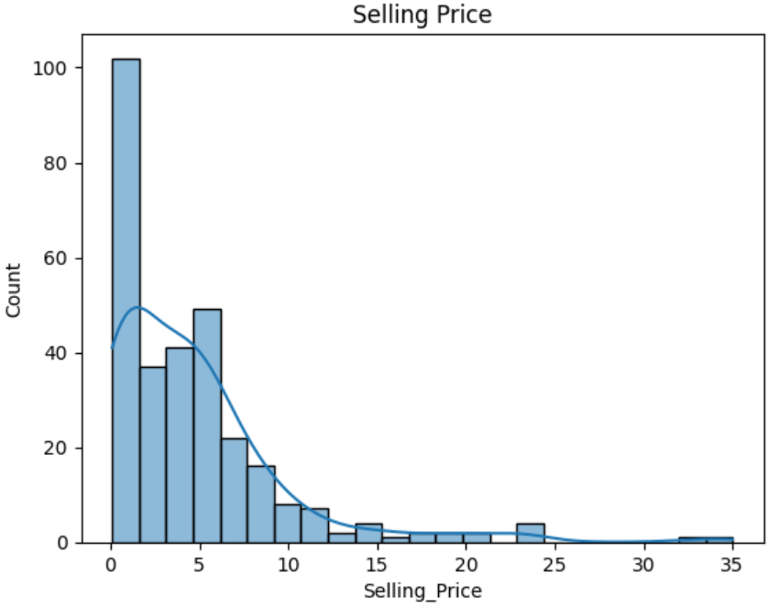
HISTOGRAM OF SELLING PRICE

Slide 15
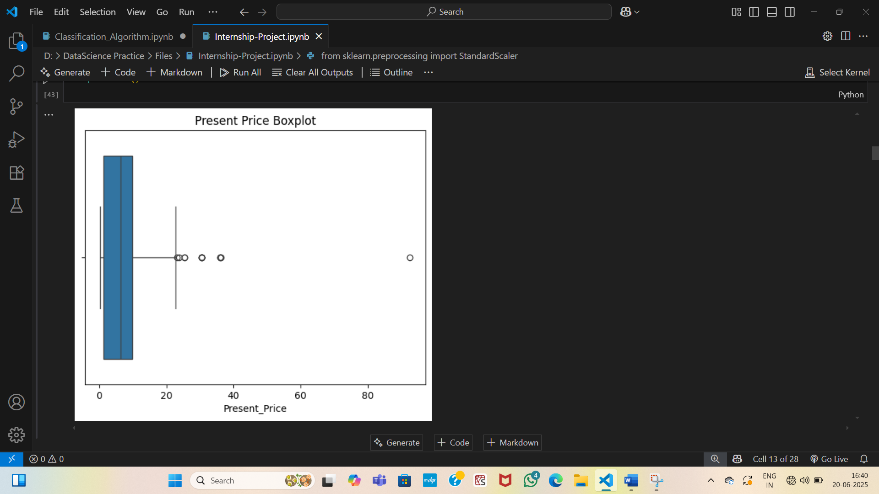
BOXPLOT FOR PRESENT PRICE

Slide 16
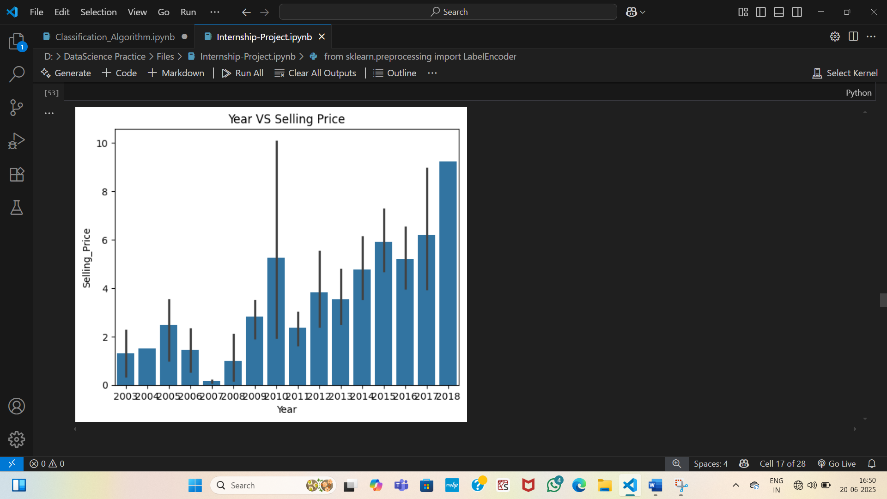
YEAR VS. SELLING PRICE

Slide 17
MODEL COMPARSION

Slide 18
Model | MAE | RMSE | R² Score
Linear Regression | 16.48% | 20.44% | 32%
Decision Tree Regressor | 9.85% | 12.12% | 76%
Random Forest Regressor | 6.96% | 10.49% | 82%
XGBoost Regressor | 6.56% | 9.74% | 84%

Slide 19
SCATTERPLOT FOR MODEL PREDICTION

Slide 20
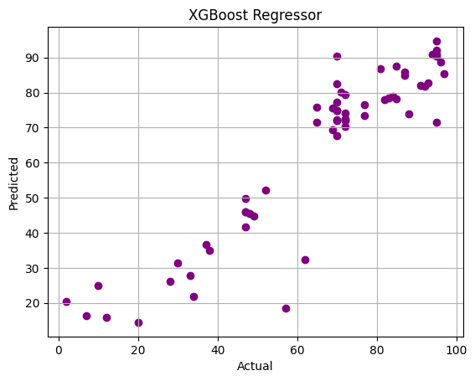
XGBoost Regressor

Slide 21
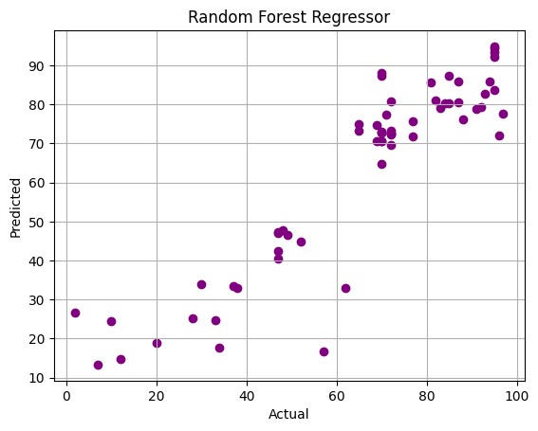
Randon Forest Regressor

Slide 22
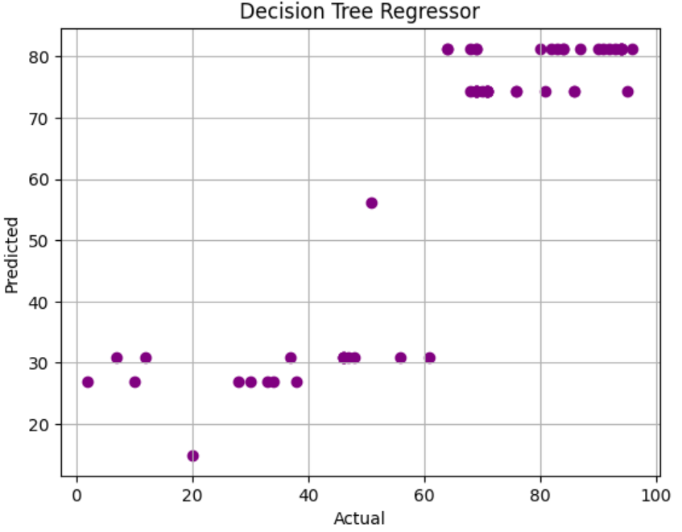
Decision Tree Regressor

Slide 23
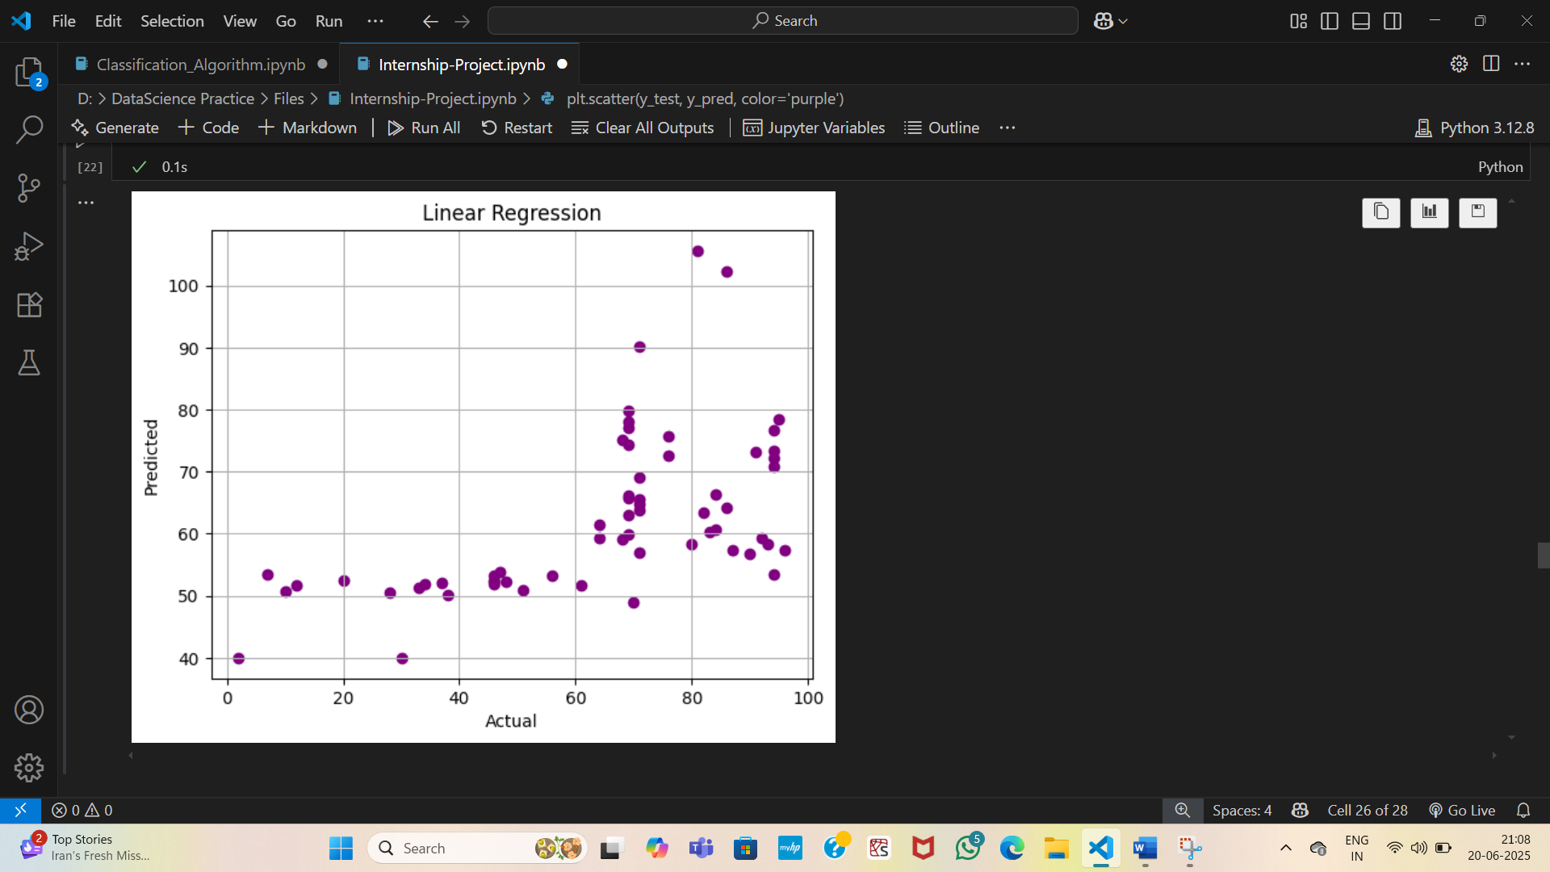
Linear Regression

Slide 24
CONCLUSION
ML effectively predicts car name.
Random Forest & XGBoost gave best accuracy.
Project improves transparency in pricing.
Practical exposure to ML workflow.
Can be scaled and integrated into real platforms.
Internship bridged gap between theory and practice in ML applications.

Slide 25
THANK YOU

